Slide 1
ANALYZING TAXIS BY LOCATION
NIKITHA REDDY VENKANNAGARI
Banner ID:810766641
nvenkann@kent.edu

Slide 2
Problem statement:
Finding the total number of taxis in a location.
Finding the total number of particular company taxis in a location to raise their business.
-by considering the fields of latitude, longitude and vendor

Slide 3
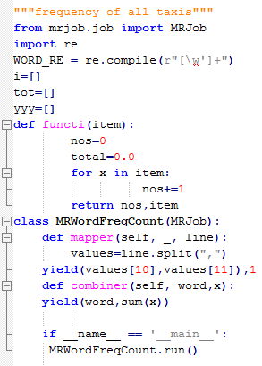
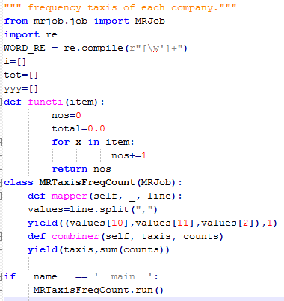
Approach:
Taxi data set is analyzed, consists of several fields.
Concentrated on pickup longitude and latitude fields for the location and the vendor type field.
MRjobs are used to run and results are produced accordingly.

Slide 4
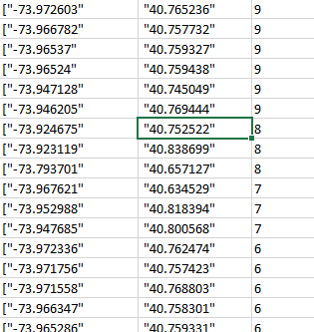
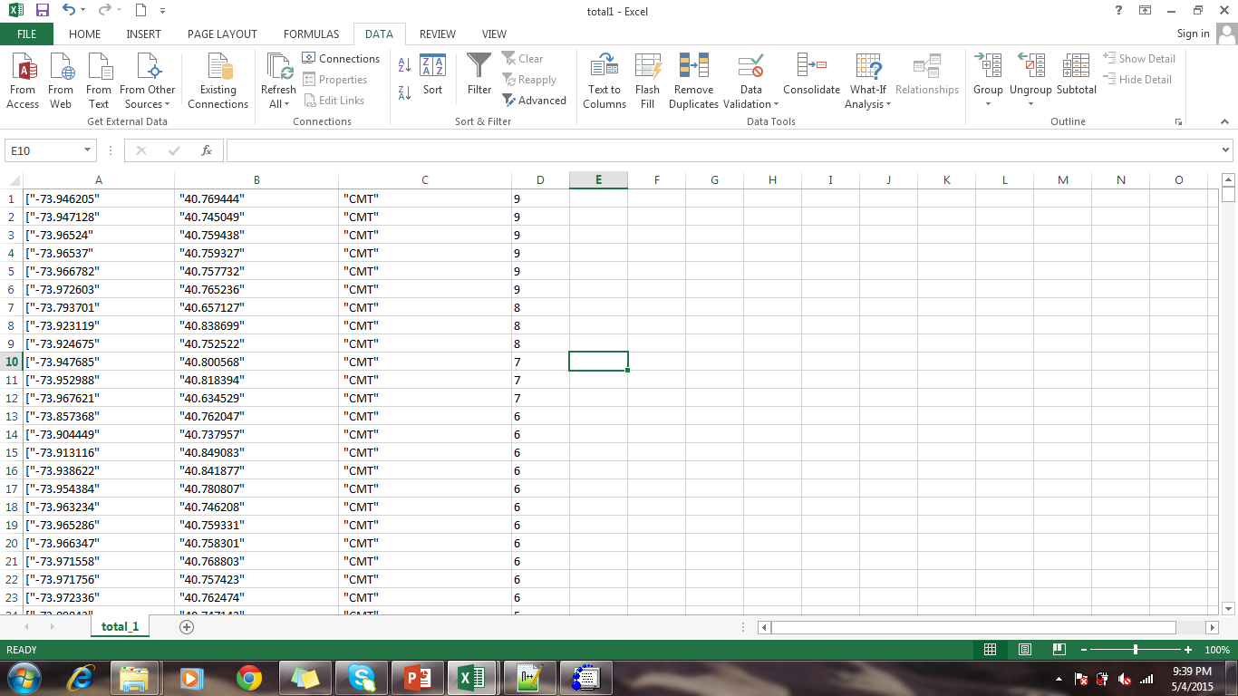
Results:
Total number of taxis of all Total number of taxis of a companies: particular company:

Slide 5
Conclusion
From the results, frequency of taxis at a particular location can be observed.
The companies can enhance their business by increasing the taxis at locations where they are low.

Slide 6
Future work
The analysis of the performance of vendor during the particular period of time can be analyzed.

Slide 7
Thank You!!!

